Slide 1
Chapter 8
Random Bit Generation and Stream Ciphers
Notes:
An important cryptographic function is the generation of random bit streams. Random
bits streams are used in a wide variety of contexts, including key generation and
encryption. In essence, there are two fundamentally different strategies for generating
random bits or random numbers. One strategy, which until recently dominated in cryptographic
applications, computes bits deterministically using an algorithm. This class of
random bit generators is known as pseudorandom number generators (PRNGs) or
deterministic random bit generators (DRBGs). The other strategy is to produce bits
non-deterministically using some physical source that produces some sort of random
output. This latter class of random bit generators is known as true random number
generators (TRNGs) or non-deterministic random bit generators (NRBGs).
The chapter begins with an analysis of the basic principles of PRNGs. Next, we
look at some common PRNGs, including PRNGs based on the use of a symmetric
block cipher. The chapter then moves on to the topic of symmetric stream ciphers,
which are based on the use of a PRNG. The chapter next examines the most important
stream cipher, RC4.
The remainder of the chapter is devoted to TRNGs. We look first at the basic
principles and structure of TRNGs, and then examine a specific product, the Intel
Digital Random Number Generator.
Throughout this chapter, reference is made to four important NIST documents:
■ SP 800-90A (Recommendation for Random Number Generation Using
Deterministic Random Bit Generators, January 2012) covers DRNGs.
■ SP 800-90B (Recommendation for the Entropy Sources Used for Random Bit
Generation, August 2012) covers criteria for entropy sources (ES), the devices
from which we get unpredictable randomness and NRNGs.
■ SP 800-90C (Recommendation for Random Bit Generator (RBG)
Constructions, August 2012) discusses how to combine the entropy sources in
90B with the DRNG’s from 90A to provide large quantities of unpredictable
bits for cryptographic applications.
■ SP 800-22 (A Statistical Test Suite for Random and Pseudorandom Number
Generators for Cryptographic Applications, April 2010) discusses the selection
and testing of NRBGs and DRBGs.
These specifications have heavily influenced the implementation of random bit
generators in industry both in the U.S. and worldwide.

Slide 2

Random Numbers
A number of network security algorithms and protocols based on cryptography make use of random binary numbers:
Key distribution and reciprocal authentication schemes
Session key generation
Generation of keys for the RSA public-key encryption algorithm
Generation of a bit stream for symmetric stream encryption
Randomness
There are two distinct requirements for a sequence of random numbers:
Unpredictability
Notes:
A number of network security algorithms and protocols based on cryptography
make use of random binary numbers. For example,
• Key distribution and reciprocal (mutual) authentication schemes, such as
those discussed in Chapters 14 and 15. In such schemes, two communicating
parties cooperate by exchanging messages to distribute keys and/or authenticate
each other. In many cases, nonces are used for handshaking to prevent
replay attacks. The use of random numbers for the nonces frustrates an opponent’s
efforts to determine or guess the nonce, in order to repeat an obsolete
transaction.
• Session key generation. We will see a number of protocols in this book where
a secret key for symmetric encryption is generated for use for a particular
transaction (or session) and is valid for a short period of time. This key is
generally called a session key.
• Generation of keys for the RSA public-key encryption algorithm (described
in Chapter 9).
• Generation of a bit stream for symmetric stream encryption (described in this
chapter).
These applications give rise to two distinct and not necessarily compatible
requirements for a sequence of random numbers: randomness and unpredictability.

Slide 3
Randomness
The generation of a sequence of allegedly random numbers being random in some well-defined statistical sense has been a concern
Two criteria are used to validate that a sequence of numbers is random:
Uniform distribution
The frequency of occurrence of ones and zeros should be approximately equal
Independence
No one subsequence in the sequence can be inferred from the others
Notes:
Traditionally, the concern in the generation of a sequence of allegedly
random numbers has been that the sequence of numbers be random in some
well-defined statistical sense. The following two criteria are used to validate that a
sequence of numbers is random:
• Uniform distribution: The distribution of bits in the sequence should be uniform;
that is, the frequency of occurrence of ones and zeros should be approximately
equal.
• Independence: No one subsequence in the sequence can be inferred from the
others.
Although there are well-defined tests for determining that a sequence of bits
matches a particular distribution, such as the uniform distribution, there is no such
test to “prove” independence. Rather, a number of tests can be applied to demonstrate
if a sequence does not exhibit independence. The general strategy is to apply
a number of such tests until the confidence that independence exists is sufficiently
strong. That is, if each of a number of tests fails to show that a sequence of bits is
not independent, then we can have a high level of confidence that the sequence is in
fact independent.

Slide 4
Unpredictability
The requirement is not just that the sequence of numbers be statistically random, but that the successive members of the sequence are unpredictable
With “true” random sequences each number is statistically independent of other numbers in the sequence and therefore unpredictable
True random numbers have their limitations, such as inefficiency, so it is more common to implement algorithms that generate sequences of numbers that appear to be random
Care must be taken that an opponent not be able to predict future elements of the sequence on the basis of earlier elements
Notes:
In applications such as reciprocal authentication, session key
generation, and stream ciphers, the requirement is not just that the sequence of
numbers be statistically random but that the successive members of the sequence
are unpredictable. With “true” random sequences, each number is statistically independent
of other numbers in the sequence and therefore unpredictable. Although
true random numbers are used in some applications, they have their limitations,
such as inefficiency, as is discussed shortly. Thus, it is more common to implement
algorithms that generate sequences of numbers that appear to be random. In this
latter case, care must be taken that an opponent not be able to predict future elements
of the sequence on the basis of earlier elements.

Slide 5
Pseudorandom Numbers
Cryptographic applications typically make use of algorithmic techniques for random number generation
These algorithms are deterministic and therefore produce sequences of numbers that are not statistically random
If the algorithm is good, the resulting sequences will pass many tests of randomness and are referred to as pseudorandom numbers
Notes:
Cryptographic applications typically make use of algorithmic techniques for random
number generation. These algorithms are deterministic and therefore produce
sequences of numbers that are not statistically random. However, if the algorithm is
good, the resulting sequences will pass many tests of randomness. Such numbers are
referred to as pseudorandom numbers .
You may be somewhat uneasy about the concept of using numbers generated
by a deterministic algorithm as if they were random numbers. Despite what might be
called philosophical objections to such a practice, it generally works. That is, under
most circumstances, pseudorandom numbers will perform as well as if they were
random for a given use. The phrase “as well as” is unfortunately subjective, but the
use of pseudorandom numbers is widely accepted. The same principle applies
in statistical applications, in which a statistician takes a sample of a population and
assumes that the results will be approximately the same as if the whole population
were measured

Slide 6
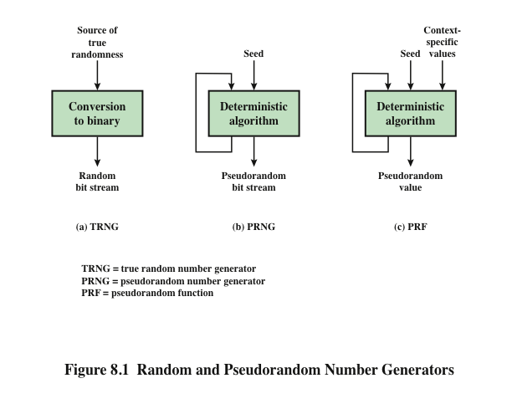
Notes:
Figure 8.1 contrasts a true random number generator (TRNG) with two forms
of pseudorandom number generators.

Slide 7
True Random Number Generator (TRNG)
Takes as input a source that is effectively random
The source is referred to as an entropy source and is drawn from the physical environment of the computer
Includes things such as keystroke timing patterns, disk electrical activity, mouse movements, and instantaneous values of the system clock
The source, or combination of sources, serve as input to an algorithm that produces random binary output
The TRNG may simply involve conversion of an analog source to a binary output
The TRNG may involve additional processing to overcome any bias in the source
Notes:
A TRNG takes as input a source that is effectively
random; the source is often referred to as an entropy source.
In essence, the entropy source is drawn from the physical
environment of the computer and could include things such as keystroke timing
patterns, disk electrical activity, mouse movements, and instantaneous values of the
system clock.
The source, or combination of sources, serve as input to an algorithm
that produces random binary output. The TRNG may simply involve conversion of
an analog source to a binary output. The TRNG may involve additional processing
to overcome any bias in the source; this is discussed in Section 8.6.

Slide 8
Pseudorandom Number Generator (PRNG)
Takes as input a fixed value, called the seed, and produces a sequence of output bits using a deterministic algorithm
Quite often the seed is generated by a TRNG
The output bit stream is determined solely by the input value or values, so an adversary who knows the algorithm and the seed can reproduce the entire bit stream
Other than the number of bits produced there is no difference between a PRNG and a PRF
Two different forms of PRNG
Pseudorandom number generator
An algorithm that is used to produce an open-ended sequence of bits
Input to a symmetric stream cipher is a common application for an open-ended sequence of bits
Pseudorandom function (PRF)
Used to produce a pseudorandom string of bits of some fixed length
Examples are symmetric encryption keys and nonces
Notes:
In contrast, a PRNG takes as input a fixed value, called the seed , and produces
a sequence of output bits using a deterministic algorithm. Quite often, the seed is
generated by a TRNG. Typically, as shown, there is some feedback path by which
some of the results of the algorithm are fed back as input as additional output bits
are produced. The important thing to note is that the output bit stream is determined
solely by the input value or values, so that an adversary who knows the algorithm
and the seed can reproduce the entire bit stream.
Figure 8.1 shows two different forms of PRNGs, based on application.
• Pseudorandom number generator: An algorithm that is used to produce an
open-ended sequence of bits is referred to as a PRNG. A common application
for an open-ended sequence of bits is as input to a symmetric stream cipher, as
discussed in Section 8.4. Also, see Figure 4.1a.
• Pseudorandom function (PRF): A PRF is used to produced a pseudorandom
string of bits of some fixed length. Examples are symmetric encryption keys
and nonces. Typically, the PRF takes as input a seed plus some context specific
values, such as a user ID or an application ID. A number of examples of
PRFs will be seen throughout this book, notably in Chapters 17 and 18.
Other than the number of bits produced, there is no difference between a PRNG
and a PRF. The same algorithms can be used in both applications. Both require a seed
and both must exhibit randomness and unpredictability. Further, a PRNG application
may also employ context-specific input. In what follows, we make no distinction
between these two applications.

Slide 9

PRNG Requirements
The basic requirement when a PRNG or PRF is used for a cryptographic application is that an adversary who does not know the seed is unable to determine the pseudorandom string
The requirement for secrecy of the output of a PRNG or PRF leads to specific requirements in the areas of:
Randomness
Unpredictability
Characteristics of the seed
Notes:
When a PRNG or PRF is used for a cryptographic application, then the basic
requirement is that an adversary who does not know the seed is unable to determine
the pseudorandom string. For example, if the pseudorandom bit stream is
used in a stream cipher, then knowledge of the pseudorandom bit stream would
enable the adversary to recover the plaintext from the ciphertext. Similarly, we
wish to protect the output value of a PRF. In this latter case, consider the following
scenario. A 128-bit seed, together with some context-specific values, are used
to generate a 128-bit secret key that is subsequently used for symmetric encryption.
Under normal circumstances, a 128-bit key is safe from a brute-force attack.
However, if the PRF does not generate effectively random 128-bit output values,
it may be possible for an adversary to narrow the possibilities and successfully use
a brute force attack.
This general requirement for secrecy of the output of a PRNG or PRF leads to
specific requirements in the areas of randomness, unpredictability, and the characteristics
of the seed. We now look at these in turn.

Slide 10
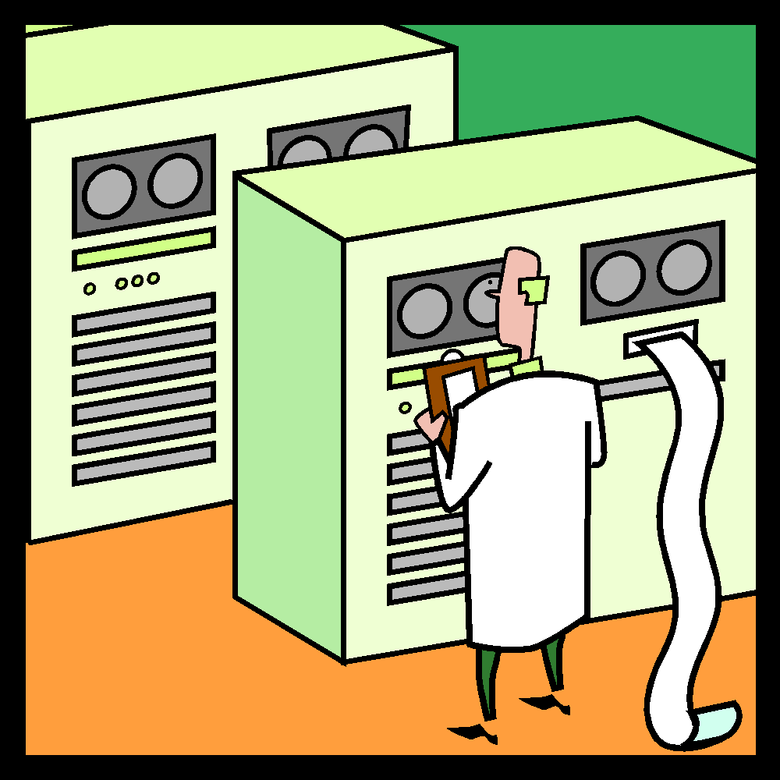
Randomness
The generated bit stream needs to appear random even though it is deterministic
There is no single test that can determine if a PRNG generates numbers that have the characteristic of randomness
If the PRNG exhibits randomness on the basis of multiple tests, then it can be assumed to satisfy the randomness requirement
NIST SP 800-22 specifies that the tests should seek to establish three characteristics:
Uniformity
Scalability
Consistency
Notes:
In terms of randomness, the requirement for a PRNG is that the generated
bit stream appear random even though it is deterministic. There is no single
test that can determine if a PRNG generates numbers that have the characteristic
of randomness. The best that can be done is to apply a sequence of tests to the
PRNG. If the PRNG exhibits randomness on the basis of multiple tests, then it can
be assumed to satisfy the randomness requirement. NIST SP 800-22
specifies that the tests should seek to establish the following three
characteristics.
• Uniformity: At any point in the generation of a sequence of random or pseudorandom
bits, the occurrence of a zero or one is equally likely, i.e., the probability
of each is exactly 1/2. The expected number of zeros (or ones) is n /2,
where n = the sequence length.
• Scalability: Any test applicable to a sequence can also be applied to subsequences
extracted at random. If a sequence is random, then any such extracted
subsequence should also be random. Hence, any extracted subsequence
should pass any test for randomness.
• Consistency: The behavior of a generator must be consistent across starting
values (seeds). It is inadequate to test a PRNG based on the output from a
single seed or an TRNG on the basis of an output produced from a single
physical output.

Slide 11
Randomness Tests
SP 800-22 lists 15 separate tests of randomness
Runs test
Focus of this test is the total number of runs in the sequence, where a run is an uninterrupted sequence of identical bits bounded before and after with a bit of the opposite value
Purpose is to determine whether the number of runs of ones and zeros of various lengths is as expected for a random sequence
Maurer’s universal statistical test
Focus is the number of bits between matching patterns
Purpose is to detect whether or not the sequence can be significantly compressed without loss of information. A significantly compressible sequence is considered to be non-random
Frequency test
The most basic test and must be included in any test suite
Purpose is to determine whether the number of ones and zeros in a sequence is approximately the same as would be expected for a truly random sequence
Three tests
Notes:
SP 800-22 lists 15 separate tests of randomness. An understanding of these
tests requires a basic knowledge of statistical analysis, so we don’t attempt a
technical description here. Instead, to give some flavor for the tests, we list three of
the tests and the purpose of each test, as follows.
• Frequency test: This is the most basic test and must be included in any test
suite. The purpose of this test is to determine whether the number of ones and
zeros in a sequence is approximately the same as would be expected for a truly
random sequence.
• Runs test: The focus of this test is the total number of runs in the sequence,
where a run is an uninterrupted sequence of identical bits bounded before
and after with a bit of the opposite value. The purpose of the runs test is to
determine whether the number of runs of ones and zeros of various lengths is
as expected for a random sequence.
• Maurer’s universal statistical test: The focus of this test is the number of bits
between matching patterns (a measure that is related to the length of a compressed
sequence). The purpose of the test is to detect whether or not the
sequence can be significantly compressed without loss of information. A significantly
compressible sequence is considered to be non-random.

Slide 12
Unpredictability
A stream of pseudorandom numbers should exhibit two forms of unpredictability:
Forward unpredictability
If the seed is unknown, the next output bit in the sequence should be unpredictable in spite of any knowledge of previous bits in the sequence
Backward unpredictability
It should not be feasible to determine the seed from knowledge of any generated values
No correlation between a seed and any value generated from that seed should be evident
Each element of the sequence should appear to be the outcome of an independent random event whose probability is 1/2
The same set of tests for randomness also provides a test of unpredictability
A random sequence will have no correlation with a fixed value (the seed)
Notes:
A stream of pseudorandom numbers should exhibit two forms
of unpredictability:
• Forward unpredictability : If the seed is unknown, the next output bit in the
sequence should be unpredictable in spite of any knowledge of previous bits in
the sequence.
• Backward unpredictability : It should also not be feasible to determine the
seed from knowledge of any generated values. No correlation between a seed
and any value generated from that seed should be evident; each element of the
sequence should appear to be the outcome of an independent random event
whose probability is 1/2.
The same set of tests for randomness also provide a test of unpredictability. If the
generated bit stream appears random, then it is not possible to predict some bit or bit
sequence from knowledge of any previous bits. Similarly, if the bit sequence appears
random, then there is no feasible way to deduce the seed based on the bit sequence.
That is, a random sequence will have no correlation with a fixed value (the seed).

Slide 13

Seed Requirements
The seed that serves as input to the PRNG must be secure and unpredictable
The seed itself must be a random or pseudorandom number
Typically the seed is generated by TRNG
Notes:
For cryptographic applications, the seed that serves as input to
the PRNG must be secure. Because the PRNG is a deterministic algorithm, if the
adversary can deduce the seed, then the output can also be determined. Therefore,
the seed must be unpredictable. In fact, the seed itself must be a random or pseudorandom
number.

Slide 14
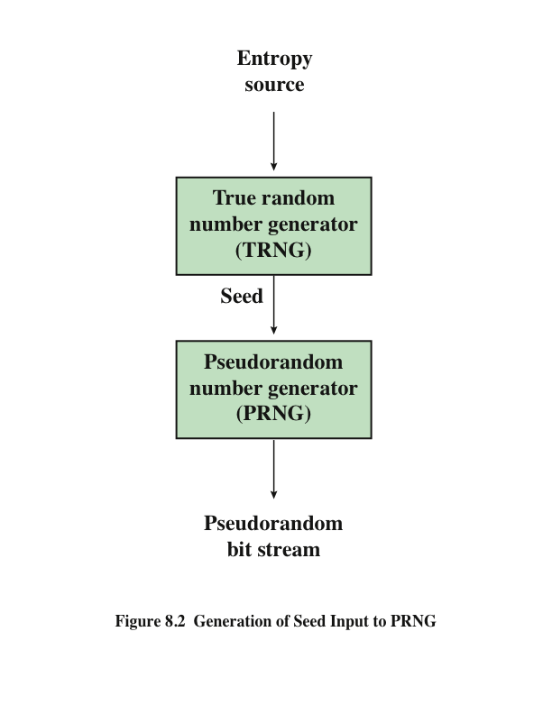
Notes:
Typically, the seed is generated by a TRNG, as shown in Figure 8.2. This is the
scheme recommended by SP800-90. The reader may wonder, if a TRNG is available,
why it is necessary to use a PRNG. If the application is a stream cipher, then
a TRNG is not practical. The sender would need to generate a keystream of bits as
long as the plaintext and then transmit the keystream and the ciphertext securely to
the receiver. If a PRNG is used, the sender need only find a way to deliver the stream
cipher key, which is typically 54 or 128 bits, to the receiver in a secure fashion.
Even in the case of a PRF application, in which only a limited number of bits
is generated, it is generally desirable to use a TRNG to provide the seed to the
PRF and use the PRF output rather than use the TRNG directly. As is explained
in Section 8.6, a TRNG may produce a binary string with some bias. The PRF
would have the effect of “randomizing” the output of the TRNG so as to eliminate
that bias.
Finally, the mechanism used to generate true random numbers may not be
able to generate bits at a rate sufficient to keep up with the application requiring
the random bits.

Slide 15
Algorithm Design
Algorithms fall into two categories:
Purpose-built algorithms
Algorithms designed specifically and solely for the purpose of generating pseudorandom bit streams
Algorithms based on existing cryptographic algorithms
Have the effect of randomizing input data
Three broad categories of cryptographic algorithms are commonly used to create PRNGs:
Symmetric block ciphers
Asymmetric ciphers
Hash functions and message authentication codes
Notes:
Cryptographic PRNGs have been the subject of much research over the years,
and a wide variety of algorithms have been developed. These fall roughly into two
categories.
• Purpose-built algorithms: These are algorithms designed specifically and
solely for the purpose of generating pseudorandom bit streams. Some of these
algorithms are used for a variety of PRNG applications; several of these are
described in the next section. Others are designed specifically for use in a
stream cipher. The most important example of the latter is RC4, described in
Section 8.5.
• Algorithms based on existing cryptographic algorithms: Cryptographic algorithms
have the effect of randomizing input data. Indeed, this is a requirement
of such algorithms. For example, if a symmetric block cipher produced
ciphertext that had certain regular patterns in it, it would aid in the process of
cryptanalysis. Thus, cryptographic algorithms can serve as the core of PRNGs.
Three broad categories of cryptographic algorithms are commonly used to
create PRNGs:
—Symmetric block ciphers: This approach is discussed in Section 8.3.
—Asymmetric ciphers: The number theoretic concepts used for an asymmetric
cipher can also be adapted for a PRNG; this approach is examined in
Chapter 10.
—Hash functions and message authentication codes: This approach is examined
in Chapter 12.
Any of these approaches can yield a cryptographically strong PRNG.
A purpose-built algorithm may be provided by an operating system for general use.
For applications that already use certain cryptographic algorithms for encryption
or authentication, it makes sense to reuse the same code for the PRNG. Thus, all of
these approaches are in common use.

Slide 16
RC4
Designed in 1987 by Ron Rivest for RSA Security
Variable key size stream cipher with byte-oriented operations
Based on the use of a random permutation
Eight to sixteen machine operations are required per output byte and the cipher can be expected to run very quickly in software
Used in the Secure Sockets Layer/Transport Layer Security (SSL/TLS) standards that have been defined for communication between Web browsers and servers
Is also used in the Wired Equivalent Privacy (WEP) protocol and the newer WiFi Protected Access (WPA) protocol that are part of the IEEE 802.11 wireless LAN standard
Notes:
RC4 is a stream cipher designed in 1987 by Ron Rivest for RSA Security. It is a variable
key size stream cipher with byte-oriented operations. The algorithm is based
on the use of a random permutation. Analysis shows that the period of the cipher
is overwhelmingly likely to be greater than 10¹⁰⁰ [ROBS95a]. Eight to sixteen machine
operations are required per output byte, and the cipher can be expected to
run very quickly in software. RC4 is used in the Secure Sockets Layer/Transport
Layer Security (SSL/TLS) standards that have been defined for communication between
Web browsers and servers. It is also used in the Wired Equivalent Privacy
(WEP) protocol and the newer WiFi Protected Access (WPA) protocol that are
part of the IEEE 802.11 wireless LAN standard. RC4 was kept as a trade secret by
RSA Security. In September 1994, the RC4 algorithm was anonymously posted on
the Internet on the Cypherpunks anonymous remailers list.
The RC4 algorithm is remarkably simple and quite easy to explain. A variable-length
key of from 1 to 256 bytes (8 to 2048 bits) is used to initialize a 256-byte state
vector S, with elements S[0], S[1], c , S[255]. At all times, S contains a permutation
of all 8-bit numbers from 0 through 255. For encryption and decryption, a byte k (see
Figure 8.7) is generated from S by selecting one of the 255 entries in a systematic
fashion. As each value of k is generated, the entries in S are once again permuted.

Slide 17
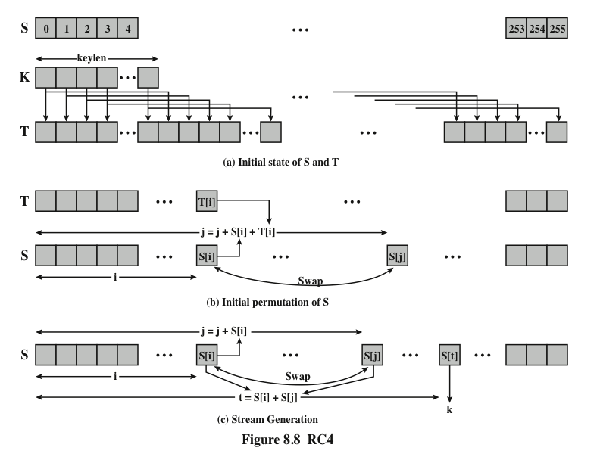
Notes:
Figure 8.8 illustrates the RC4 logic.

Slide 18
Strength of RC4
A number of papers have been published analyzing methods of attacking RC4
A more serious problem is that the WEP protocol intended to provide confidentiality on 802.11 wireless LAN networks is vulnerable to a particular attack approach
None of these approaches is practical against RC4 with a reasonable key length
The problem is not with RC4 itself, but the way in which keys are generated for use as input
Problem does not appear to be relevant to other applications and can be remedied in WEP by changing the way in which keys are generated
Problem points out the difficulty in designing a secure system that involves both cryptographic functions and protocols that make use of them
Notes:
A number of papers have been published analyzing methods of attacking RC4
(e.g., [KNUD98], [FLUH00], [MANT01]). None of these approaches is practical
against RC4 with a reasonable key length, such as 128 bits. A more serious problem
is reported in [FLUH01]. The authors demonstrate that the WEP protocol,
intended to provide confidentiality on 802.11 wireless LAN networks, is vulnerable
to a particular attack approach. In essence, the problem is not with RC4 itself
but the way in which keys are generated for use as input to RC4. This particular
problem does not appear to be relevant to other applications using RC4 and can be
remedied in WEP by changing the way in which keys are generated. This problem
points out the difficulty in designing a secure system that involves both cryptographic
functions and protocols that make use of them.

Slide 19
Entropy Sources
A true random number generator (TRNG) uses a nondeterministic source to produce randomness
Most operate by measuring unpredictable natural processes such as pulse detectors of ionizing radiation events, gas discharge tubes, and leaky capacitors
Intel has developed a commercially available chip that samples thermal noise by amplifying the voltage measured across undriven resistors
LavaRnd is an open source project for creating truly random numbers using inexpensive cameras, open source code, and inexpensive hardware
The system uses a saturated CCD in a light-tight can as a chaotic source to produce the seed; software processes the result into truly random numbers in a variety of formats
Notes:
A true random number generator (TRNG) uses a nondeterministic source to
produce randomness. Most operate by measuring unpredictable natural processes,
such as pulse detectors of ionizing radiation events, gas discharge tubes,
and leaky capacitors. Intel has developed a commercially available chip that samples
thermal noise by amplifying the voltage measured across undriven resistors
[JUN99]. LavaRnd is an open source project for creating truly random numbers
using inexpensive cameras, open source code, and inexpensive hardware. The
system uses a saturated CCD in a light-tight can as a chaotic source to produce
the seed. Software processes the result into truly random numbers in a variety of
formats.

Slide 20
Possible Sources of Randomness
RFC 4086 lists the following possible sources of randomness that can be used on a computer to generate true random sequences:
Sound/video input
Disk drives
The input from a sound digitizer with no source plugged in or from a camera with the lens cap on is essentially thermal noise
Have small random fluctuations in their rotational speed due to chaotic air turbulence
If the system has enough gain to detect anything, such input can provide reasonable high quality random bits
The addition of low-level disk seek-time instrumentation produces a series of measurements that contain this randomness
There is also an online service (random.org) which can deliver random sequences securely over the Internet
Notes:
RFC 4086 lists the following possible sources of randomness that, with care,
easily can be used on a computer to generate true random sequences.
• Sound/video input: Many computers are built with inputs that digitize some
real-world analog source, such as sound from a microphone or video input
from a camera. The “input” from a sound digitizer with no source plugged
in or from a camera with the lens cap on is essentially thermal noise. If the
system has enough gain to detect anything, such input can provide reasonably
high quality random bits.
• Disk drives: Disk drives have small random fluctuations in their rotational
speed due to chaotic air turbulence [JAKO98]. The addition of low-level disk
seek-time instrumentation produces a series of measurements that contain
this randomness. Such data is usually highly correlated, so significant processing
is needed. Nevertheless, experimentation a decade ago showed that, with
such processing, even slow disk drives on the slower computers of that day
could easily produce 100 bits a minute or more of excellent random data.
There is also an online service (random.org), which can deliver random
sequences securely over the Internet.

Slide 21
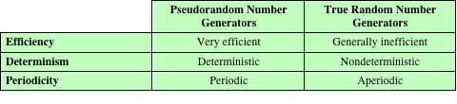
Table 8.5
Comparison of PRNGs and TRNGs
Notes:
Table 8.5 summarizes the principal differences between PRNGs and TRNGs.
PRNGs are efficient, meaning they can produce many numbers in a short time, and
deterministic, meaning that a given sequence of numbers can be reproduced at a
later date if the starting point in the sequence is known. Efficiency is a nice characteristic
if your application needs many numbers, and determinism is handy if you
need to replay the same sequence of numbers again at a later stage. PRNGs are
typically also periodic, which means that the sequence will eventually repeat itself.
While periodicity is hardly ever a desirable characteristic, modern PRNGs have a
period that is so long that it can be ignored for most practical purposes.
TRNGs are generally rather inefficient compared to PRNGs, taking considerably
longer time to produce numbers. This presents a difficulty in many applications.
For example, cryptography system in banking or national security might need
to generate millions of random bits per second. TRNGs are also nondeterministic,
meaning that a given sequence of numbers cannot be reproduced, although the same
sequence may of course occur several times by chance. TRNGs have no period.

Slide 22
Conditioning
A TRNG may produce an output that is biased in some way (such as having more ones than zeros or vice versa)
Biased
NIST SP 800-90B defines a random process as biased with respect to an assumed discrete set of potential outcomes if some of those outcomes have a greater probability of occurring than do others
Entropy rate
NIST 800-90B defines entropy rate as the rate at which a digitized noise source provides entropy
Is a measure of the randomness or unpredictability of a bit string
Will be a value between 0 (no entropy) and 1 (full entropy)
Conditioning algorithms/deskewing algorithms
Methods of modifying a bit stream to further randomize the bits
Typically conditioning is done by using a cryptographic algorithm to scramble the random bits so as to eliminate bias and increase entropy
The two most common approaches are the use of a hash function or a symmetric block cipher
Notes:
A TRNG may produce an output that is biased in some way, such as having more
ones than zeros or vice versa. More generally, NIST SP 800-90B defines a random
process as biased with respect to an assumed discrete set of potential outcomes
(i.e., possible output values) if some of those outcomes have a greater probability
of occurring than do others. For example, a physical source such as electronic noise
may contain a superposition of regular structures, such as waves or other periodic
phenomena, which may appear to be random, yet are determined to be non-random
using statistical tests.
In addition to bias, another concept used by SP 800-98B is that of entropy rate .
SP 800-90B defines entropy rate as the rate at which a digitized noise source (or
entropy source) provides entropy; it is computed as the assessed amount of entropy
provided by a bit string output from the source, divided by the total number of
bits in the bit string (yielding assessed bits of entropy per output bit). This will be
a value between 0 (no entropy) and 1 (full entropy). Entropy rate is a measure
of the randomness or unpredictability of a bit string. Another way of expressing
it is that the entropy rate is k /n for a random source of length n bits and min-entropy
k . Min-entropy is a measure of the number of random bits and is explained
in Appendix F. In essence, a block of bits or a bit stream that is unbiased, and in
which each bit and each group of bits is independent of all other bits and groups of
bits will have an entropy rate of 1.
For hardware sources of random bits, the recommended approach is to assume
that there may be bias and/or an entropy rate of less than 1 and to apply techniques
to further “randomize” the bits. Various methods of modifying a bit stream for this
purpose have been developed. These are referred to as conditioning algorithms or
deskewing algorithms .
Typically, conditioning is done by using a cryptographic algorithm to “scramble”
the random bits so as to eliminate bias and increase entropy. The two most common
approaches are the use of a hash function or a symmetric block cipher.

Slide 23
Hash Function
A hash function produces an n-bit output from an input of arbitrary length
A simple way to use a hash function for conditioning is as follows:
Blocks of m input bits, with m ≥ n, are passed through the hash function and the n output bits are used as random bits
To generate a stream of random bits, successive input blocks pass through the hash function to produce successive hashed output blocks
Notes:
A hash function produces an n -bit output
from an input of arbitrary length. A simple way to use a hash function for conditioning
is as follows. Blocks of m input bits, with m Ú n , are passed through the
hash function and the n output bits are used as random bits. To generate a stream
of random bits, successive input blocks pass through the hash function to produce
successive hashed output blocks.
Operating systems typically provide a built-in mechanism for generating random
numbers. For example, Linux uses four entropy sources: mouse and keyboard
activity, disk I/O operations, and specific interrupts. Bits are generated from these
four sources and combined in a pooled buffer. When random bits are needed, the
appropriate number of bits are read from the buffer and passed through the SHA-1
hash function [GUTT06].
A more complex approach is the hash derivation function specified in
SP800-90A. Hash_df can be defined as follows:
Parameters:
input_string : The string to be hashed.
outlen : Output length.
no_of_bits_to_return : The number of bits to be returned by Hash_df. The maximum
length (max_number_of_bits ) is implementation dependent, but shall be
less than or equal to (255 * outlen ). no_of_bits_to_return is represented as a
32-bit integer.
requested_bits : The result of performing the Hash_df.

Slide 24
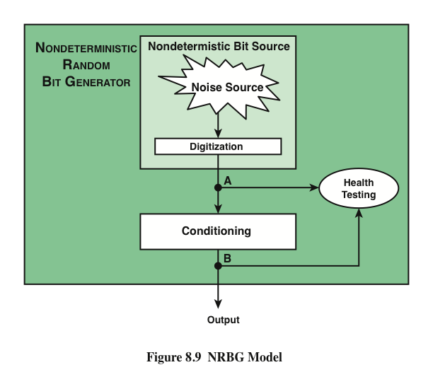
Notes:
Figure 8.9 provides a general model for a nondeterministic random bit generator.
A hardware noise source produces a true random output. This is digitized to produce
true, or nondeterministic, source of bits. This bit source then passes through a
conditioning module to mitigate bias and maximize entropy.
Figure 8.9 also shows a health-testing module, which is used on the outputs
of both the digitizer and conditioner. In essence, health testing is used to validate
that the noise source is working as expected and that the conditioning module is
produced output with the desired characteristics. Both forms of health testing are
recommended by SP 800-90B.

Slide 25
Health Tests on the Noise Source
The nature of the health testing of the noise source depends strongly on the technology used to produce noise
In general, the assumption can be made that the digitized output of the noise source will exhibit some bias
Thus, traditional statistical tests are not useful for monitoring the noise source, because the noise source is likely to always fail
The tests on the noise source need to be tailored to the expected statistical behavior of the correctly operating noise source
The goal is not to determine if the source is unbiased, but if it is operating as expected
Notes:
The nature of the health testing of the noise
source depends strongly on the technology used to produce noise. In general, we
can assume that the digitized output of the noise source will exhibit some bias. Thus,
the traditional statistical tests, such as those defined in SP 800-22 and discussed in
Section 8.1, are not useful for monitoring the noise source, because the noise source
is likely to always fail. Rather, the tests on the noise source need to be tailored to
the expected statistical behavior of the correctly operating noise source. The goal
is not to determine if the source is unbiased, which it isn’t, but if it is operating
as expected.
SP 800-90B specifies that continuous tests be done on digitized samples
obtained from the noise source (point A in Figure 8.9). The purpose is to test for
variability. More specifically, the purpose is to determine if the noise source is producing
at the expected entropy rate. SP 800-909B mandates the use of two tests: the
Repetition Count Test and the Adaptive Proportion Test.
The Repetition Count Test is designed to quickly detect a catastrophic failure
that causes the noise source to become “stuck” on a single output value for a long
time. For this test, it is assumed that a given noise source is assessed to have a given
min-entropy value of H . The entropy is expressed as the amount of entropy
per sample, where a sample could be a single bit or some block of bits of length n . With an
assessed value of H , it is straightforward to calculate the probability that a sequence
of C consecutive samples will yield identical sample values.
The Repetition Count Test starts by recording a sample value and then counting
the number of repetitions of the same value. If the counter reaches the cutoff
value C, an error is reported. If a sample value is encountered that differs from the
preceding sample, then the counter is reset to 1 and the algorithm starts over.
The Adaptive Proportion Test is designed to detect a large loss of entropy,
such as might occur as a result of some physical failure or environmental change
affecting the noise source. The test continuously measures the local frequency of
occurrence of some sample value in a sequence of noise source samples to determine
if the sample occurs too frequently

Slide 26
Health Tests on the Noise Source
SP 800-90B specifies that continuous tests be done on digitized samples obtained from the noise source
The purpose is to test for variability and to determine if the noise source is producing at the expected entropy rate
SP 800-90B mandates the use of two tests
Repetition Count Test
Designed to quickly detect a catastrophic failure that causes the noise source to become “stuck” on a single output value for a long time
Involves looking for consecutive identical samples
Adaptive Proportion Test
Designed to detect a large loss of entropy, such as might occur as a result of some physical failure or environmental change affecting the noise source
The test continuously measures the local frequency of occurrence of some sample value in a sequence of noise source samples to determine if the sample occurs too frequently
Notes:
SP 800-90B specifies that continuous tests be done on digitized samples
obtained from the noise source (point A in Figure 8.9). The purpose is to test for
variability. More specifically, the purpose is to determine if the noise source is producing
at the expected entropy rate. SP 800-909B mandates the use of two tests: the
Repetition Count Test and the Adaptive Proportion Test.
The Repetition Count Test is designed to quickly detect a catastrophic failure
that causes the noise source to become “stuck” on a single output value for a long
time. For this test, it is assumed that a given noise source is assessed to have a given
min-entropy value of H . The entropy is expressed as the amount of entropy
per sample, where a sample could be a single bit or some block of bits of length n . With an
assessed value of H , it is straightforward to calculate the probability that a sequence
of C consecutive samples will yield identical sample values.
The Repetition Count Test starts by recording a sample value and then counting
the number of repetitions of the same value. If the counter reaches the cutoff
value C, an error is reported. If a sample value is encountered that differs from the
preceding sample, then the counter is reset to 1 and the algorithm starts over.
The Adaptive Proportion Test is designed to detect a large loss of entropy,
such as might occur as a result of some physical failure or environmental change
affecting the noise source. The test continuously measures the local frequency of
occurrence of some sample value in a sequence of noise source samples to determine
if the sample occurs too frequently

Slide 27
Health Tests on the Conditioning Function
SP 800-90B specifies that health tests should also be applied to the output of the conditioning component, but does not indicate which tests to use
The purpose of the health tests on the conditioning component is to assure that the output behaves as a true random bit stream
It is reasonable to use the tests for randomness defined in SP 800-22
Notes:
SP 800-90B specifies that health tests should also be applied to the output of the conditioning component (point B in Figure 8.9), but does not indicate which tests to use. The purpose of the health
tests on the conditioning component is to assure that the output behaves as a true
random bit stream. Thus, it is reasonable to use the tests for randomness defined in
SP 800-22, and described in Section 8.1.

Slide 28
Intel Digital Random Number Generator
TRNGs have traditionally been used only for key generation and other applications where only a small number of random bits were required
This is because TRNGs have generally been inefficient with a low bit rate of random bit production
The first commercially available TRNG that achieves bit production rates comparable with that of PRNGs is the Intel digital random number generator offered on new multicore chips since May 2012
It is implemented entirely in hardware
The entire DRNG is on the same multicore chip as the processors
Notes:
As was mentioned, TRNGs have traditionally been used only for key generation
and other applications where only a small number of random bits were required.
This is because TRNGs have generally been inefficient, with a low bit rate of random
bit production.
The first commercially available TRNG that achieves bit production rates
comparable with that of PRNGs is the Intel digital random number generator
(DRNG) [TAYL11], offered on new multicore chips since May 2012.
Two notable aspects of the DRNG:
1. It is implemented entirely in hardware. This provides greater security than a facility
that includes a software component. A hardware-only implementation should
also be able to achieve greater computation speed than a software module.
2. The entire DRNG is on the same multicore chip as the processors. This eliminates
the I/O delays found in other hardware random number generators.

Slide 29
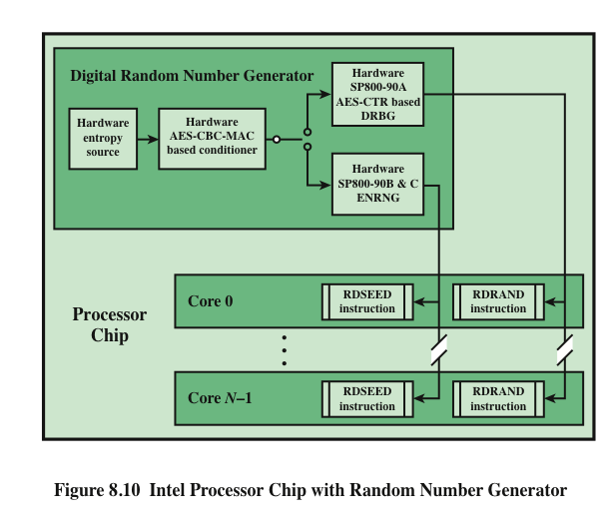
Notes:
Figure 8.10 shows the overall structure of the DRNG. The first stage of the DRNG
generates random numbers from thermal noise. The heart of the stage consists of
two inverters (NOT gates), with the output of each inverter connected to the input
of the other. Such an arrangement has two stable states, with one inverter having an
output of logical 1 and the other having an output of logical 0. The circuit is then configured
so that both inverters are forced to have the same indeterminate state (both
inputs and both outputs at logical 1) by clock pulses. Random thermal noise within
the inverters soon jostles the two inverters into a mutually stable state. Additional
circuitry is intended to compensate for any biases or correlations. This stage is
capable, with current hardware, of generating random bits at a rate of 4 Gbps.
The output of the first stage is generated 512 bits at a time. To assure that
the bit stream does not have skew or bias, a second stage of processing randomizes
its input using a cryptographic function. In this case, the function is referred to
as CBC-MAC or CMAC, as specified in NIST SP 800-38B. In essence, CMAC
encrypts its input using the cipher block chaining (CBC) mode (Figure 6.4) and
outputs the final block. We examine CMAC in detail in Chapter 12. The output of
this stage is generated 256 bits at a time and is intended to exhibit true randomness
with no skew or bias.
While the hardware’s circuitry generates random numbers from thermal noise
much more quickly than its predecessors, it’s still not fast enough for some of today’s
computing requirements. To enable the DRNG to generate random numbers
as quickly as software PRNG, and also maintain the high quality of the random numbers,
a third stage is added. This stage uses the 256-bit random numbers to seed
a cryptographically secure PRNG that creates 128-bit numbers. From one 256-bit
seed, the PRNG can output many pseudorandom numbers, exceeding the 3-Gbps
rate of the entropy source. An upper bound of 511 128-bit samples can be generated
per seed. The algorithm used for this stage is CTR_DRBG, described in Section 8.3.
The output of the DRNG is available to each of the cores on the chip via the
RDRAND instruction. RDRAND retrieves a 16-, 32-, or 64-bit random value and
makes it available in a software-accessible register.
Preliminary data from a pre-production sample on a system with a third
generation Intel® Core™ family processor produced the following performance
[INTE12]: up to 70 million RDRAND invocations per second, and a random data
production rate of over 4 Gbps.

Slide 30
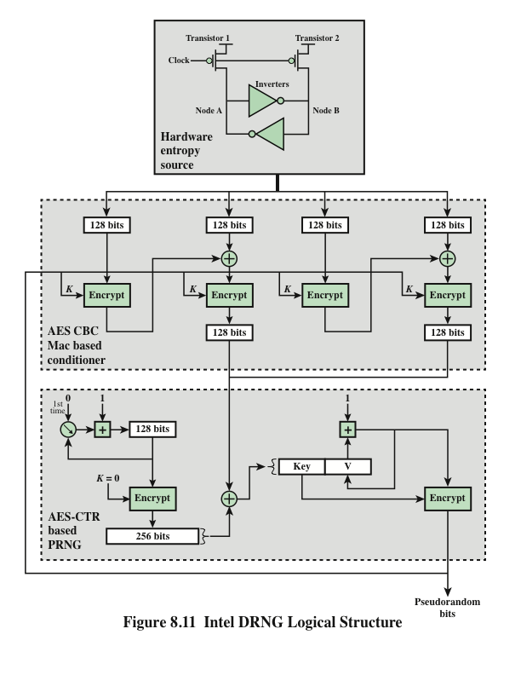
Notes:
Figure 8.11 provides a simplified view of the logical flow of the Intel DRNG. As was described,
the heart of the hardware entropy source is a pair of inverters that feed each other.
Two transistors, driven by the same clock, force the inputs and outputs of both inverters to
the logical 1 state. Because this an unstable state, thermal noise will cause the configuration
to settle randomly into a stable state with either Node A at logical 1 and Node B at
logical 0, or the reverse. Thus the module generates random bits at the clock rate.
The output of the entropy source is collected 512 bits at a time and used to
feed to two CBC hardware implementations using AES encryption. Each implementation
takes two blocks of 128 bits of “plaintext” and encrypts using the CBC
mode. The output of the second encryption is retained. For both CBC modules, an
all-zeros key is used initially. Subsequently, the output of the PRNG stage is fed
back to become the key for the conditioner stage.
The output of the conditioner stage consists of 256 bits. This block is provided
as input to the update function of the PRNG stage. The update function is initialized
with the all-zeros key and the counter value 0. The function is iterated twice to
produce a 256-bit block, which is then XORed with the input from the conditioner
stage. The results are used as the 128-bit key and the 128-bit seed for the generate
function. The generate function produces pseudorandom bits in 128-bit blocks.

Slide 31
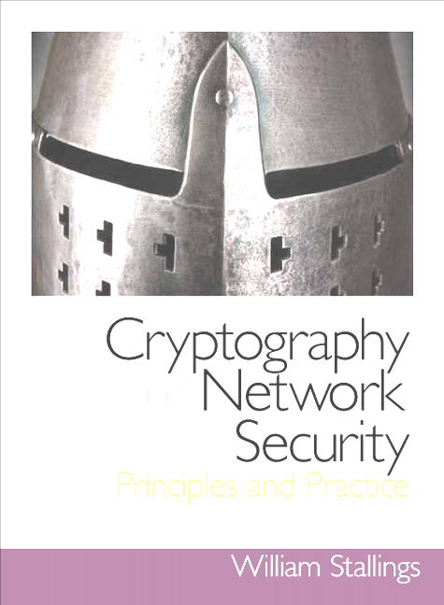
Summary
Principles of pseudorandom number generation
The use of random numbers
TRNGs, PRNGs, and PRFs
PRNG requirements
Algorithm design
Pseudorandom number generators
Linear congruential generators
Blum Blum Shub generator
Pseudorandom number generation using a block cipher
PRNG using block cipher modes of operation
ANSI X9.17 PRNG
NIST CTR_DRBG
Stream ciphers
RC4
Initialization of S
Stream generation
Strength of RC4
True random number generators
Entropy sources
Comparison of PRNGs and TRNGs
Conditioning
Health Testing
Intel digital random number generator
Notes:
Chapter 8 summary.

